Slide 1


Capstone Project
PGP-DSE FEB – 2019
Group IV
Group members:
Dedeepya
Ghouse
Rakesh
Shiva
Research Supervisor:
Anjana Agarwal

Slide 2

Predicting Customer Intention during Online
purchase

Slide 3
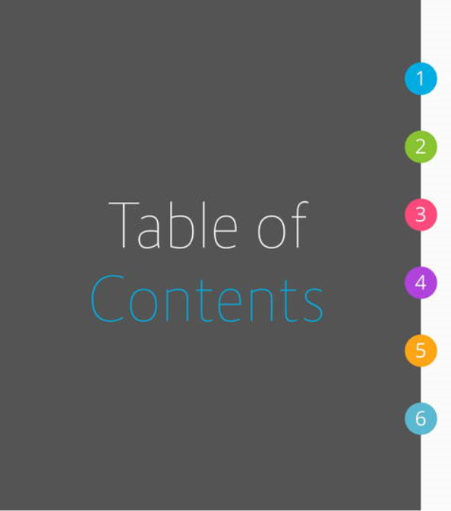
Introduction
Problem Statement
EDA using Tableau
Modelling & Evaluation metrics
Challenges
Suggestions and Conclusion

Slide 4

Introduction
Online shopping is the easy solution for busy life in today’s world.
In the past decade, there had been a massive change in the way of customer’s shopping.
Despite consumers’ continuation to buy from a physical store, the users or buyers feel very convenient
Online shopping saves crucial time for modern people because they get so busy that they cannot or unwilling to spend much time shopping.

Slide 5

People often spend a lot of time browsing through online shopping websites, but the conversion rate into purchases is low.
Determine the likelihood of purchase based on the given features in the dataset.
The dataset consists of feature vectors belonging to online sessions.
The purpose of this project is to identify user behaviour patterns to effectively understand features that influence the sales.

Slide 6


Purpose of this project is to identify user
behaviour patterns to effectively
understand features that influence the
purchasing decisions
To identify the list of attributes that are
finally converting into revenues by
building classification models using
existing data
To provide personalized User experience
to the users once they login to the portal.

Slide 7

The dataset consists of feature vectors belonging to 12,330 sessions.
The dataset was formed so that each session would belong to a different user in a 1-year period to avoid any tendency to a specific campaign, special day, user profile, or period.
The dataset consists of 8 numerical and 10 categorical attributes.

Slide 8
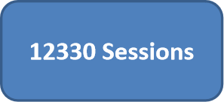
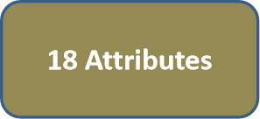
8 numerical
10 categorical

Slide 9

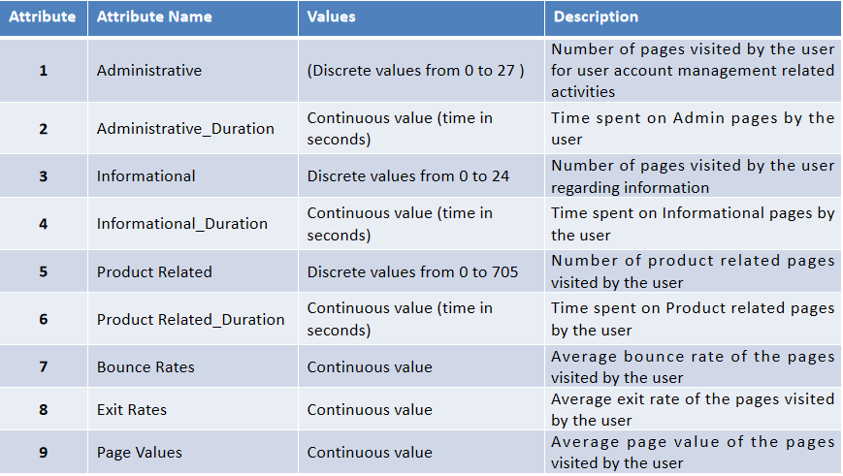

Slide 10
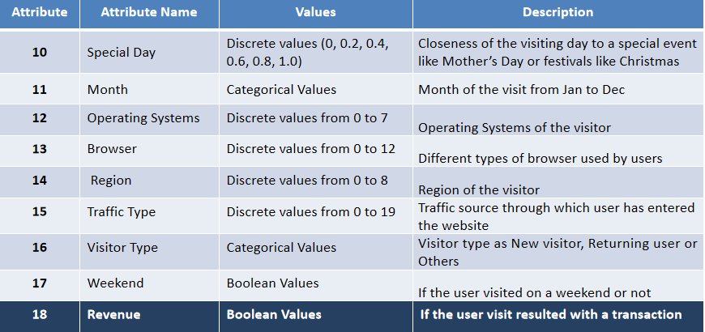
Revenue
Target Variable

Slide 11

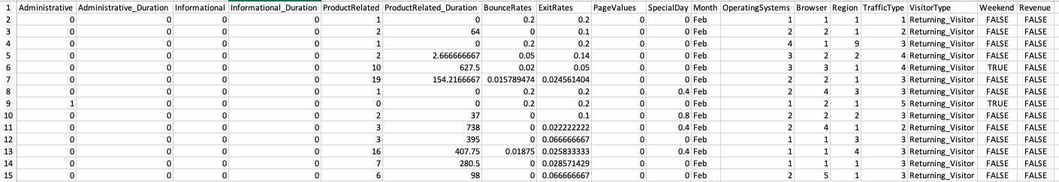
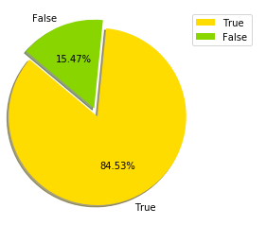
This is the Sample look of the online customer intention dataset
Shape of the Dataset is (12330, 18)
Rows: 12330
Columns:18
Target Variable is: Revenue(categorical variable) which contains TRUE and FALSE values
False 84.5%
True 15.4% Name: Revenue, dtype: float64

Slide 12

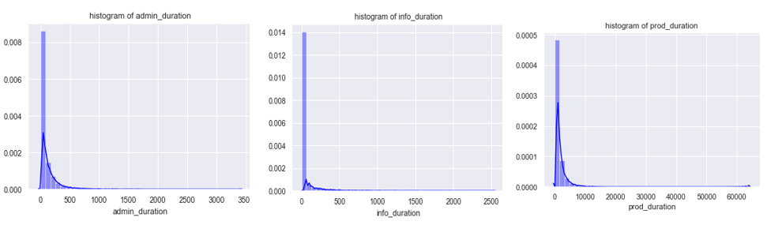
admin_duration, info_duration & product_duration attributes are Pareto distributed(long tailed) which explains that most online customers are spending very few seconds or not spending anytime on Administrative and informational related pages.

Slide 13
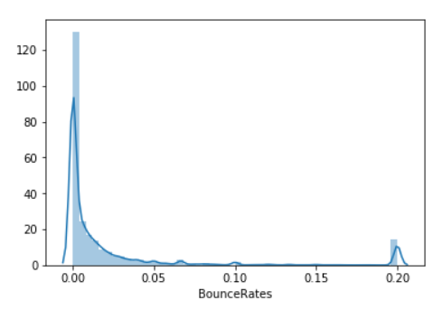
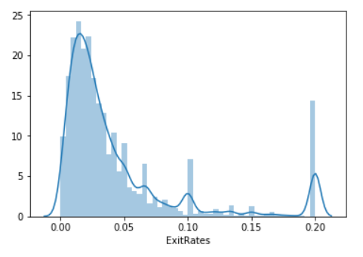
Bounce Rate : The Percentage of single-engagement sessions. Exit Rate : The Percentage of exits on a page.
Bounce_rate attribute is having Pareto distribution(long tailed) which explains that most online customers are spending very few seconds or not spending anytime on these related pages on the other hand Exit Rate is also having Pareto distribution(long tailed) but comparatively much better distribution because the customers are spending more time in pages.

Slide 14

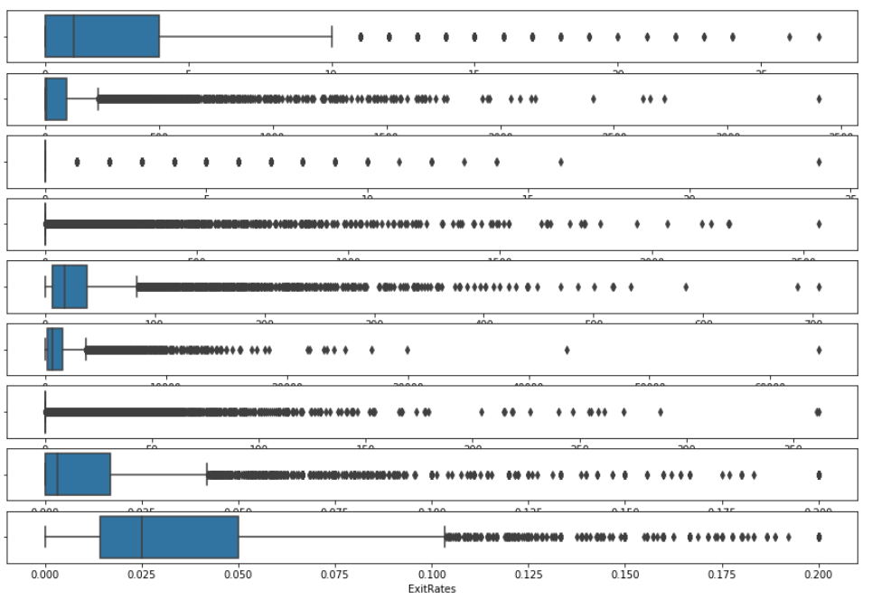

Slide 15

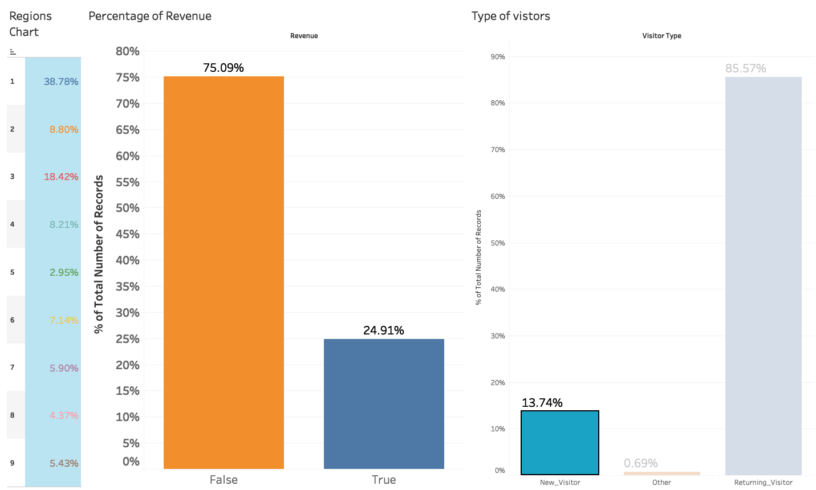
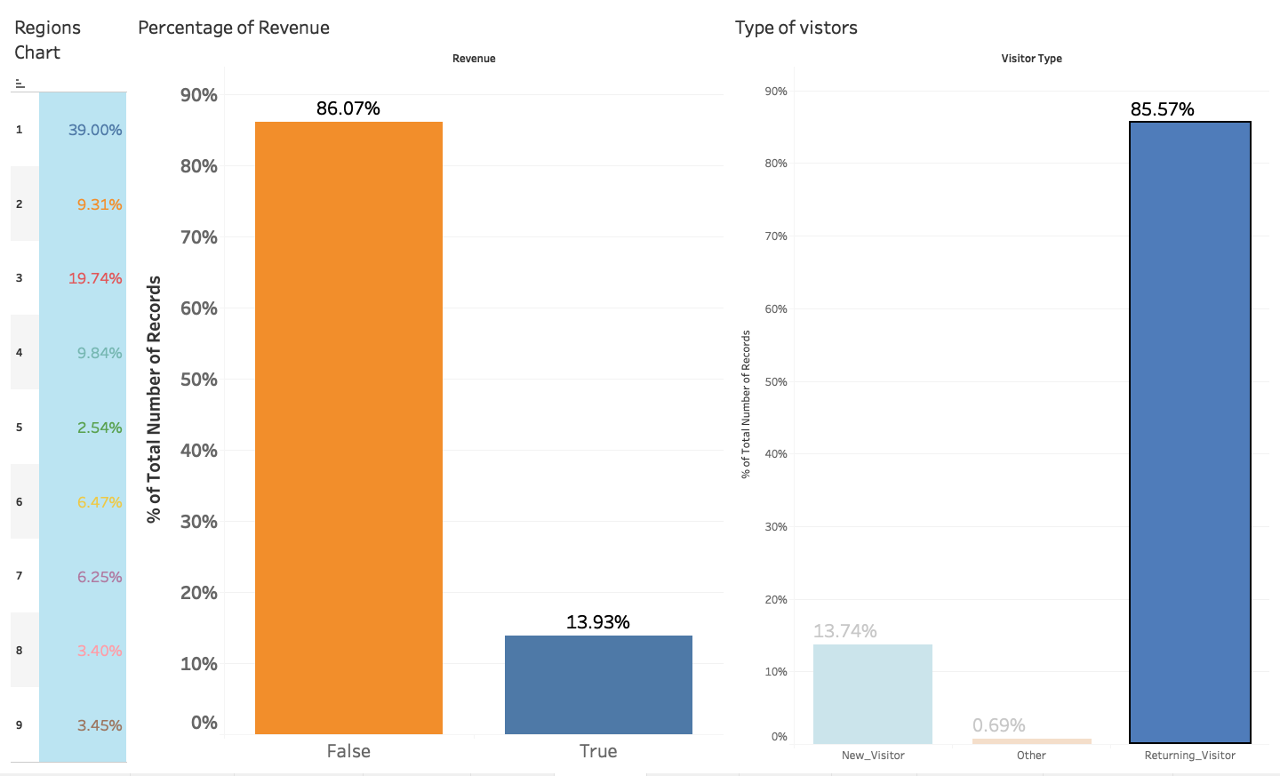
Revenue Based analysis:
New Visitors
Returning Visitors
Observation: New visitors Revenue conversion rate is high than the
returning Visitors and Others.

Slide 16
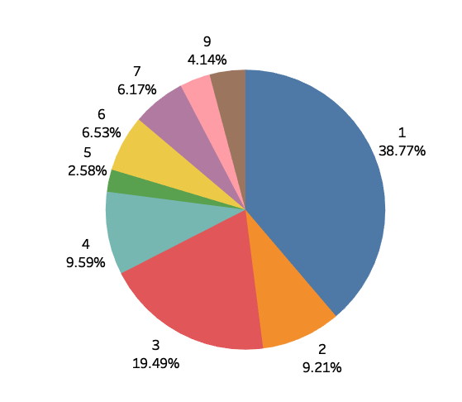
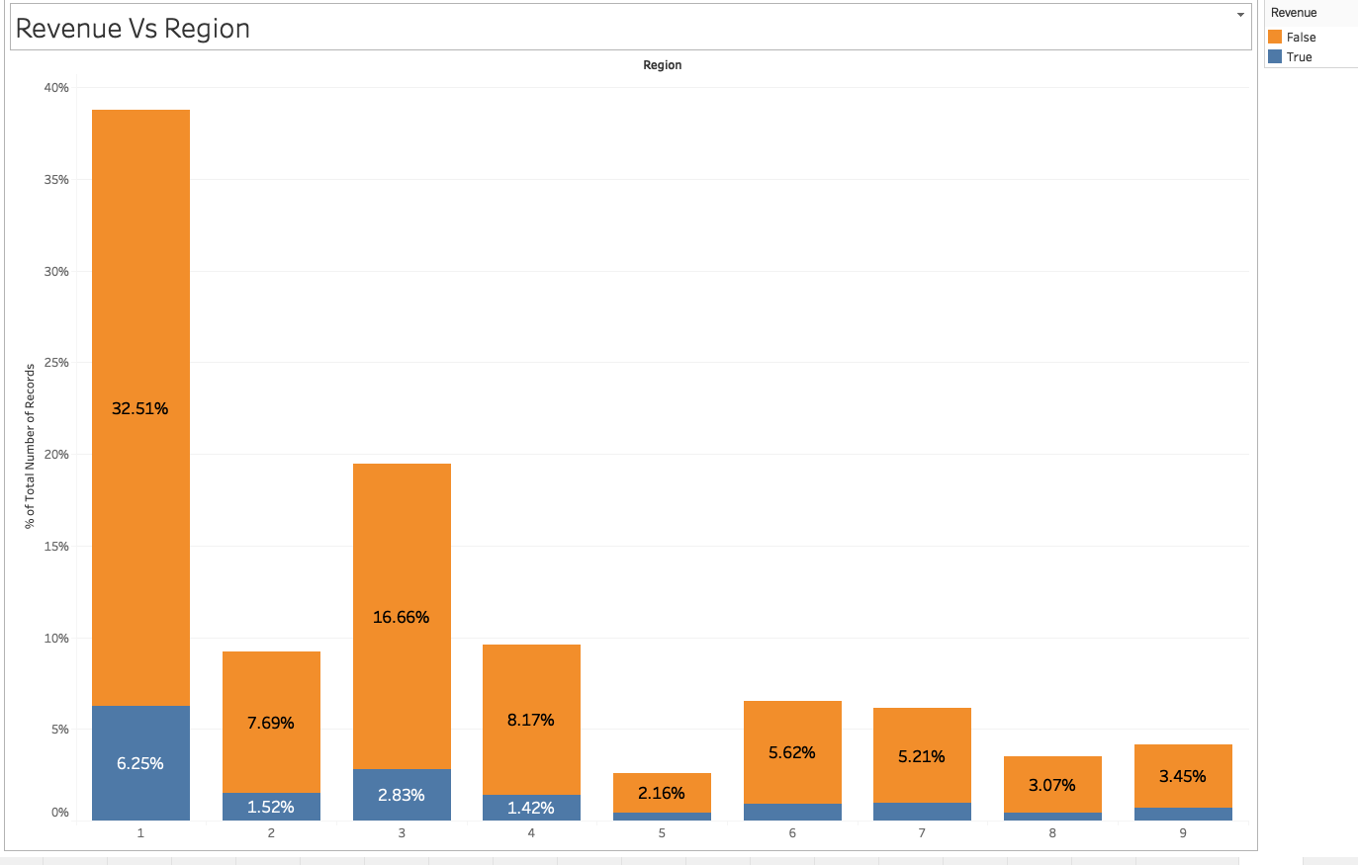
Percentage of Revenue Region records :
Percentage of Revenue Generating and not generating in Region.
Less customers are from Region 5
Most of the Customers are from Region “1”..... I.e. 38.77% and Only 6.25% of the customers are Generating Revenue.

Slide 17
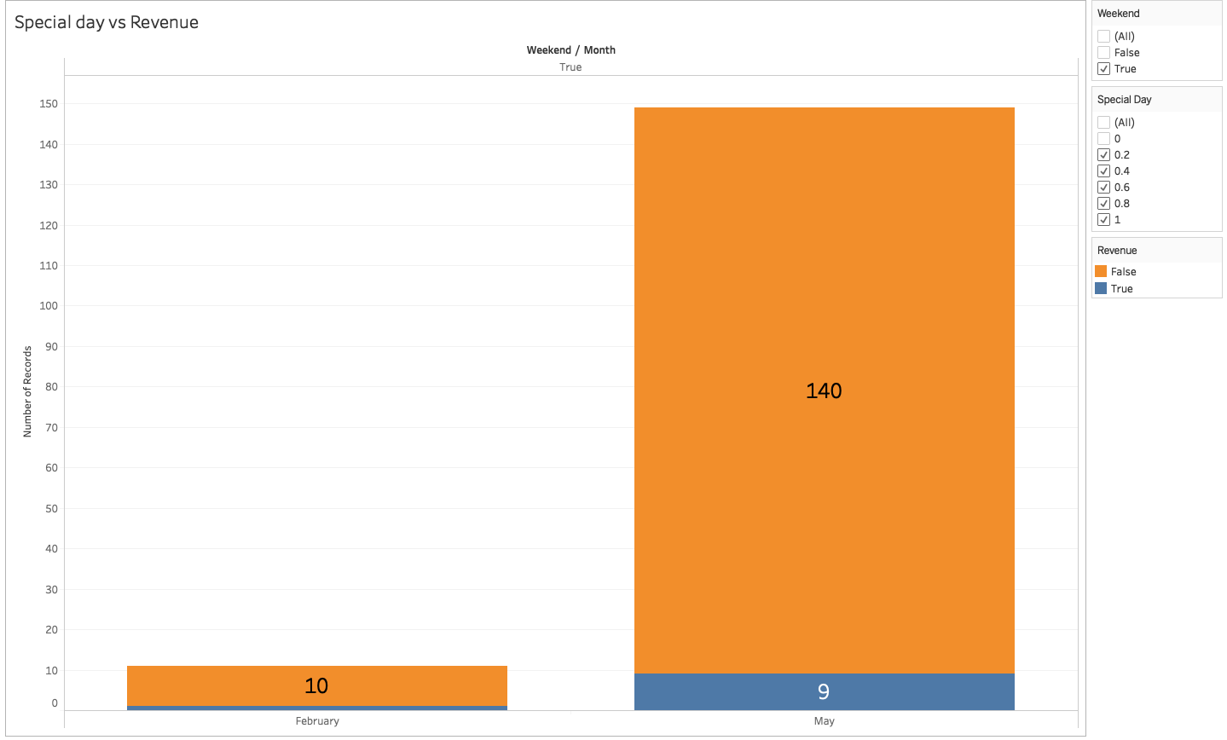
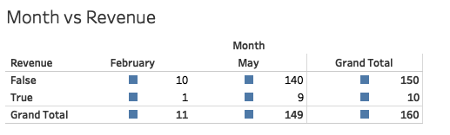
Weekend-Special day Count
There are 160 days which are special days and weekends and conversion rate count of customer to generate revenue is 9.

Slide 18

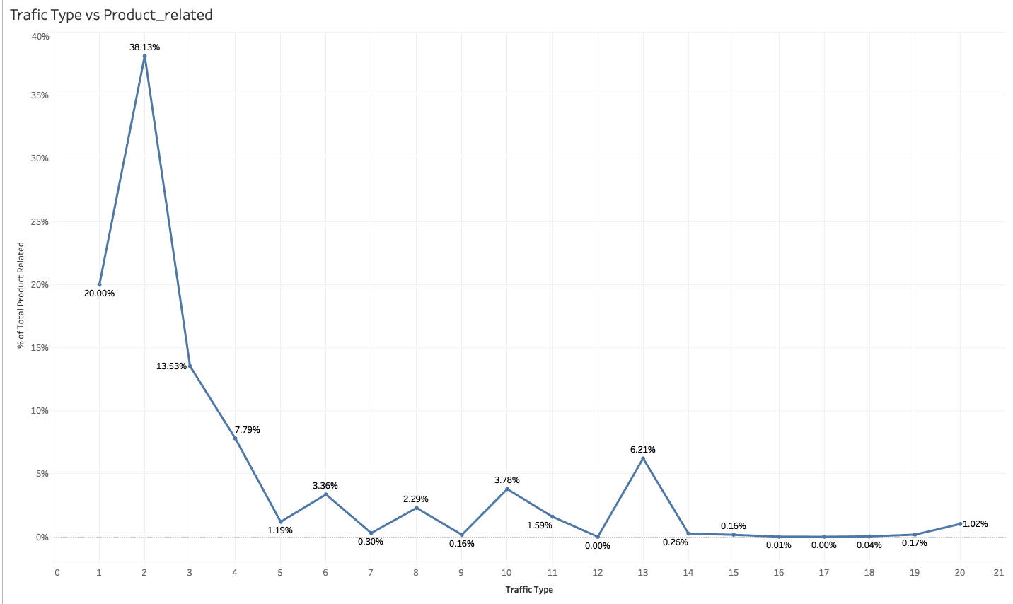
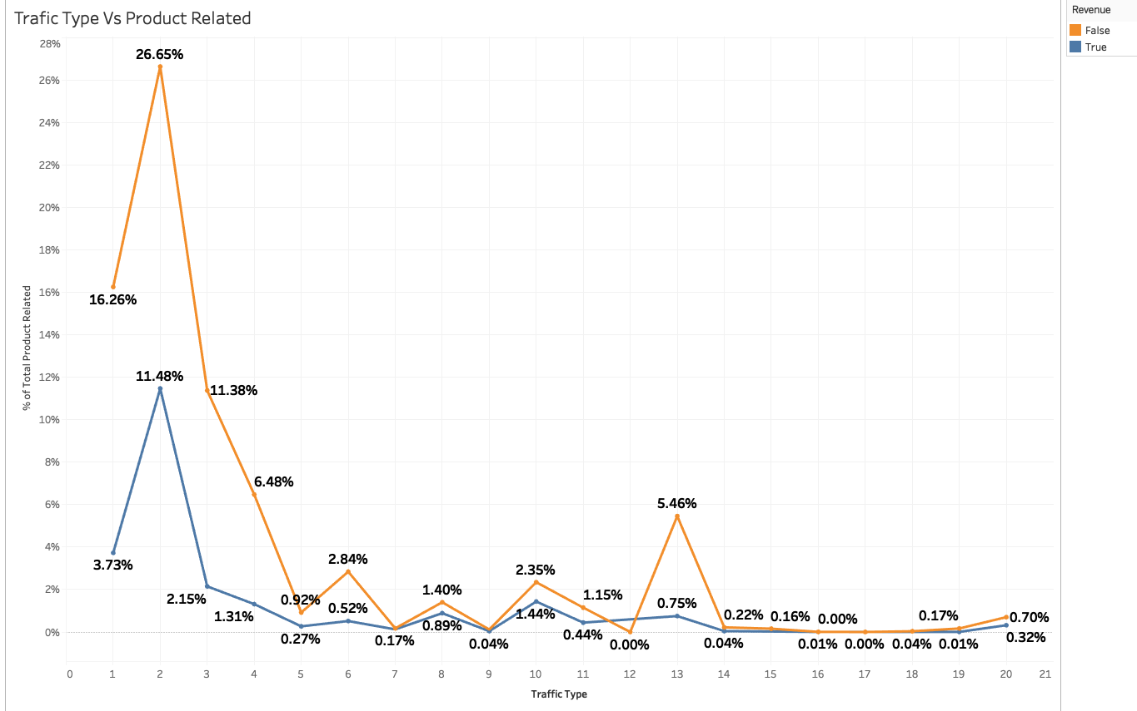
Visits Based analysis:
Visits from the Traffic type :
Max from Traffic Type “2”
Min from Traffic Type “16,17 etc”

Slide 19
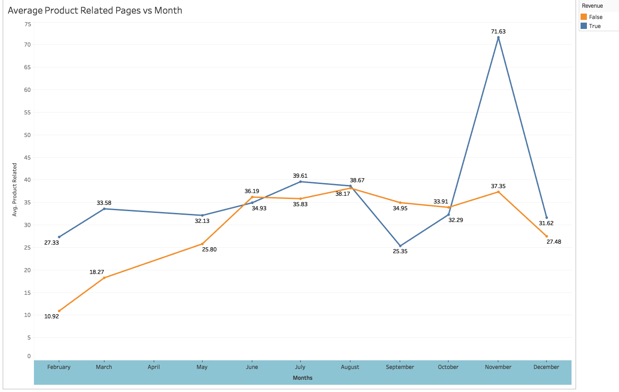
Average Product related pages visited
Revenue Generating visitor are visiting more product related pages.
Averagely it is high in November and low in September.

Slide 20
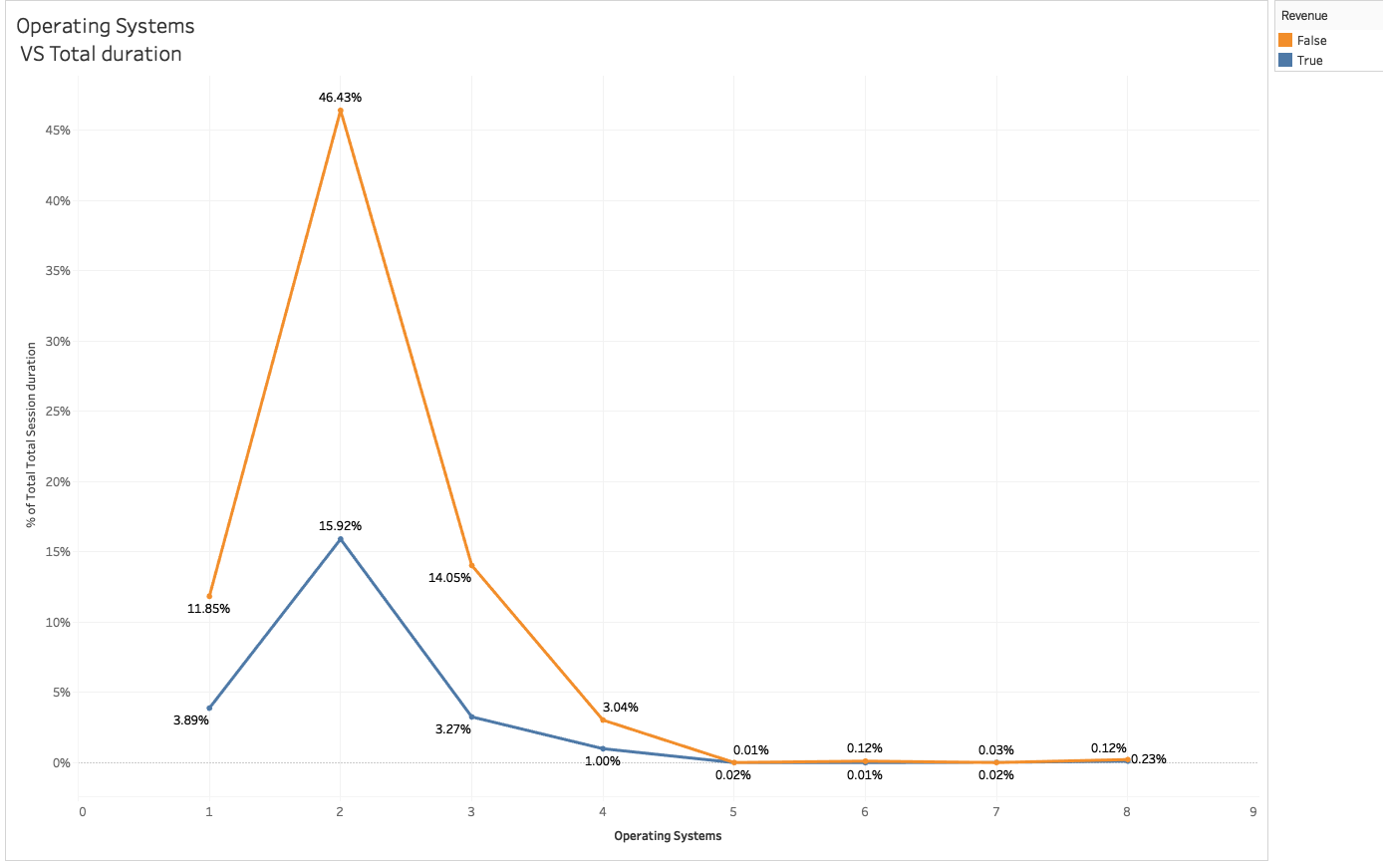
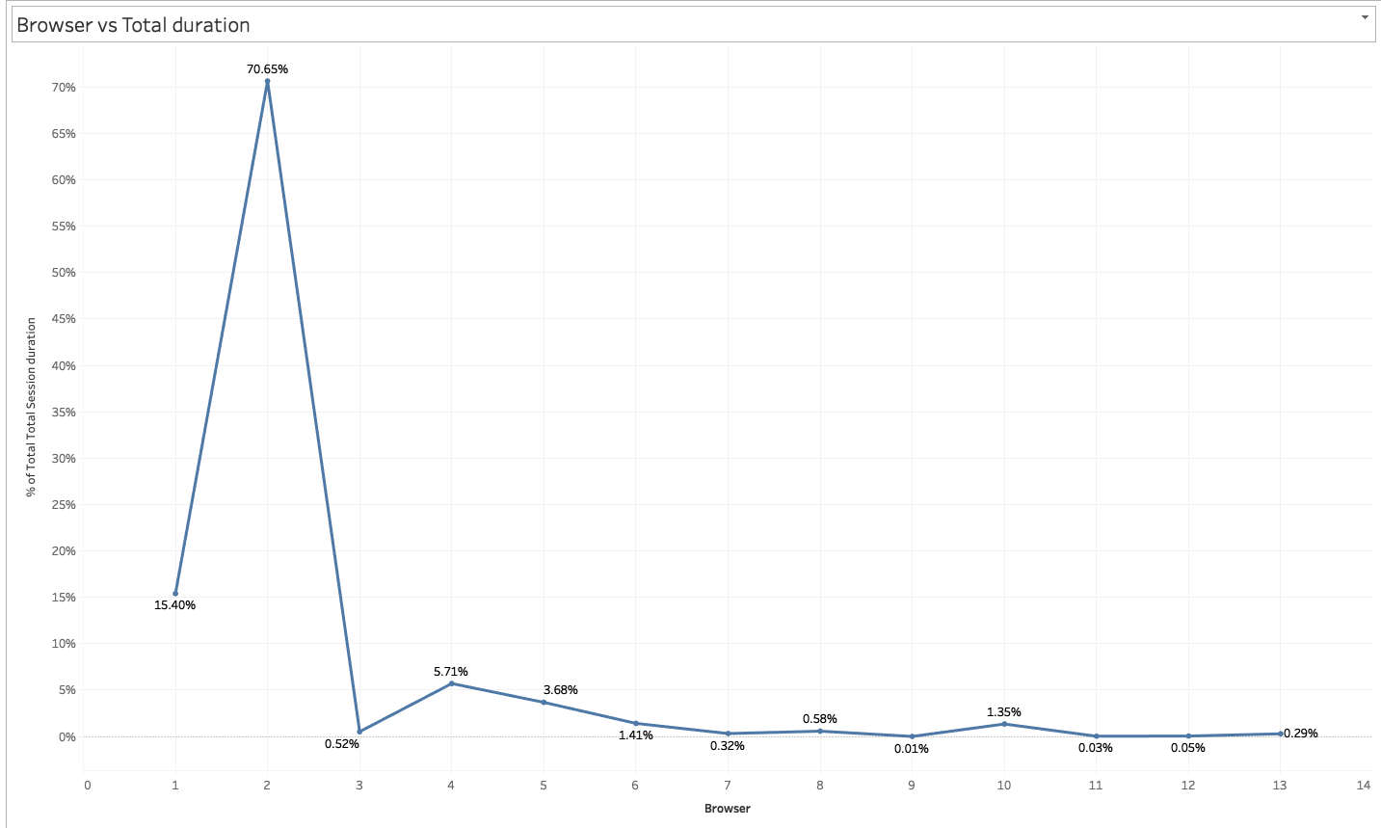
Operating system Type 2 has highest customer visits when compared to other OS.
Browser Type “2” is having highest customer visits

Slide 21

Base
Model
Parameter
Tuning
Feature Engineering
Model
Building
Outliers
Challenges
Feature
Importance
Statistical
Tests

Slide 22

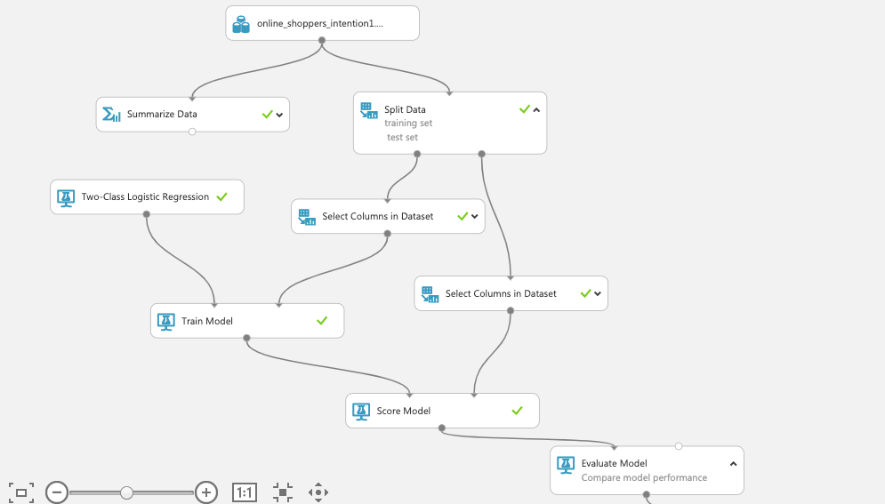
Modelling :
Logistic Regression as the Base model
Flow chart explains the underlying steps in model creations
Accuracy: 88.03%
Precision: 72.2%
Recall: 38.4%
F1_score: 49.8%
Cohen’s Kappa : 45.6%

Slide 23

Understanding the Domain
Dealing with Outliers /Extreme Values
Presence of high skewness in the data
High imbalance in the target variable.
Base model gave us very low F1 score

Slide 24
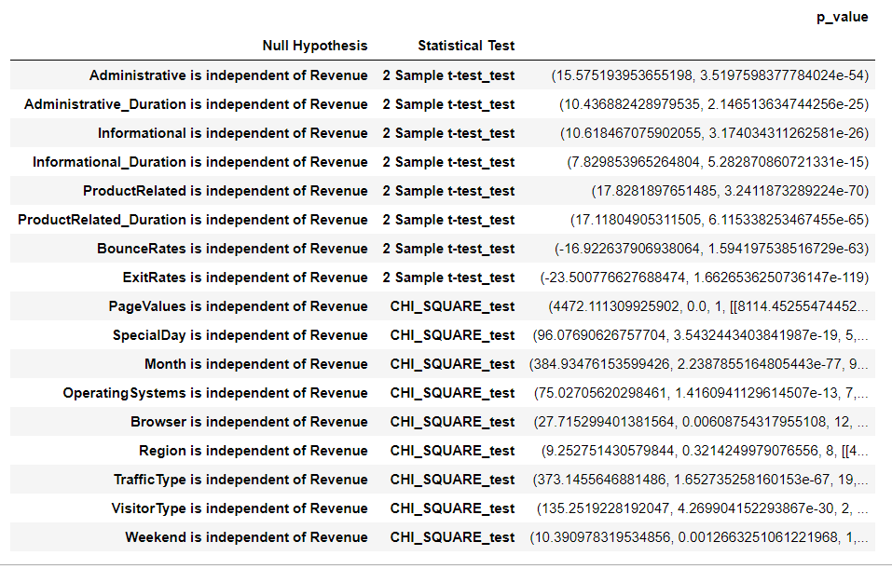
2 Sample t-test & Chi-SQuare Test For Independence
The p_value for Region variable is greater than 0.05 so it is not significant in Predicting Target Variable (Revenue), Except Region Variable remaining all variables are having p_value less than 0.05

Slide 25
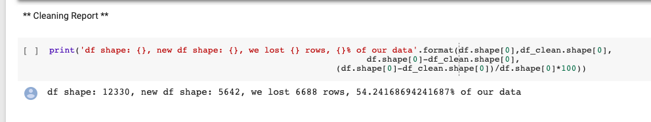
Outlier treatment:
IQR is used to treat the outliers.
Upper fence= Q3+1.5(IQR)
Lower Fence=Q1-1.5(IQR)
After treating the outliers we saw 54.24% of data is getting lost

Slide 26

Administrative
Adminsitrative_Duration
Informational
Informational_Duration
Product Related
ProductRelated_Duration
Bounce_Rates
ExitRates
PageValues
On the above features we have done Feature engineering, we created categories in it by this way we have dealt with the Extreme Values/Outliers and skewness.

Slide 27
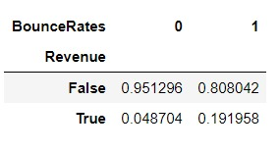
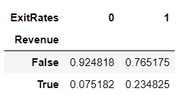
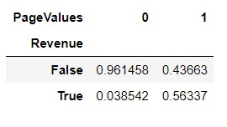
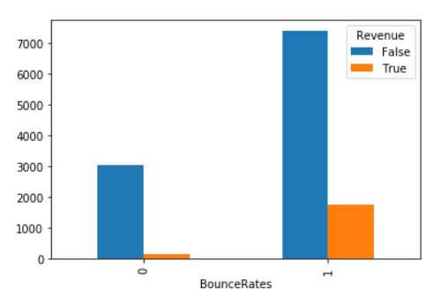
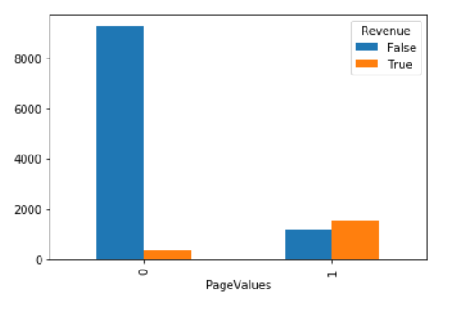
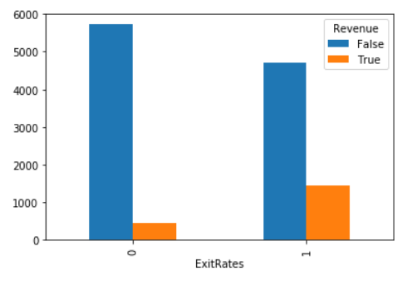

Slide 28
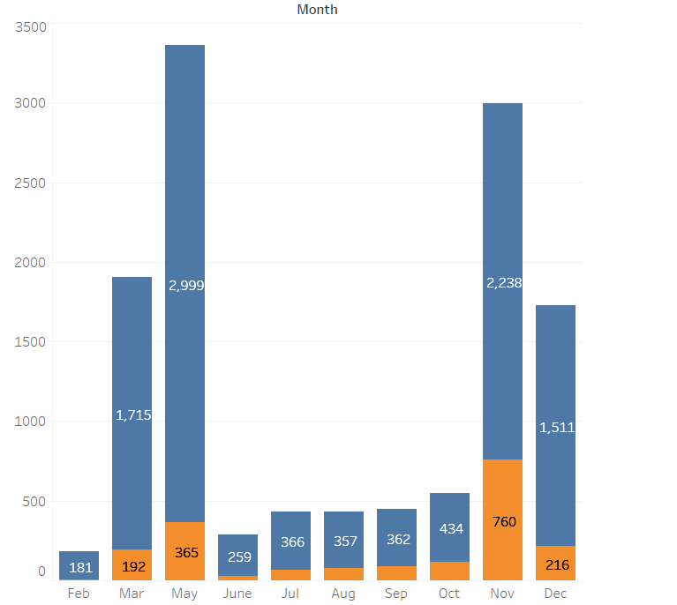

We have assigned the order to the months as per the conversion rate of revenue generated

Slide 29
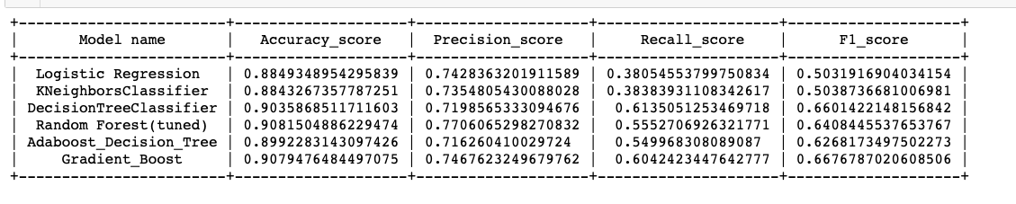
Before Feature extraction model has very drastic scores.
Accuracy wise they are good but recall score is too low. Which means underfit models.
To Deal with the above problems we followed differents steps in training algorithm like...

Slide 30

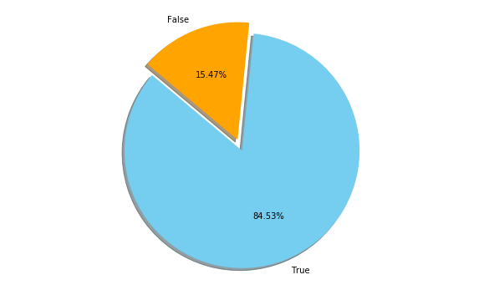
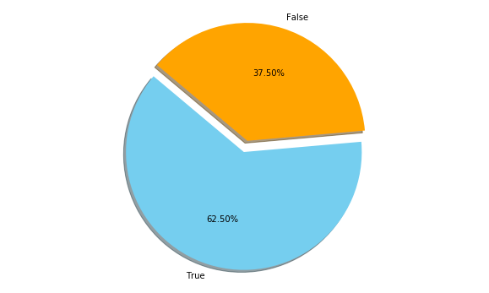
Before Upsampling, Count of Label 1 : After Upsampling, Count of Label 1 :
Before Upsampling, Count of Label 2 : After Upsampling, Count of Label 2 :
SMOTE (Synthetic Minority Over-sampling Technique) :
- It's the process of creating a new minority classes from the dataset.
- The training set is balanced.

Slide 31
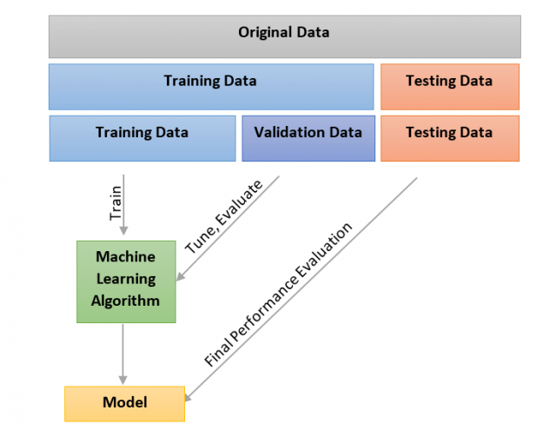
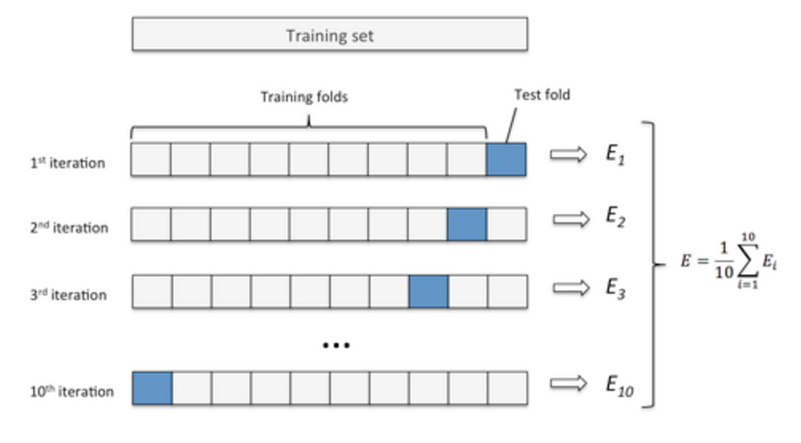
Train
Validation(dev)
Test
Methodology

Slide 32

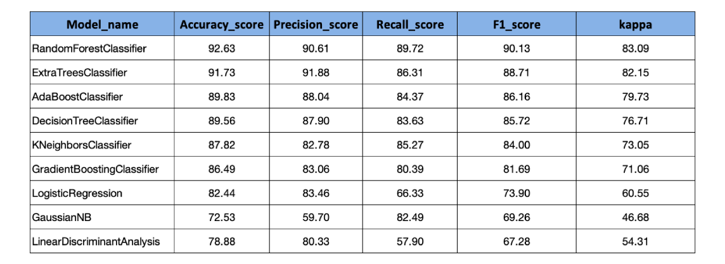
Model Comparisons

Slide 33
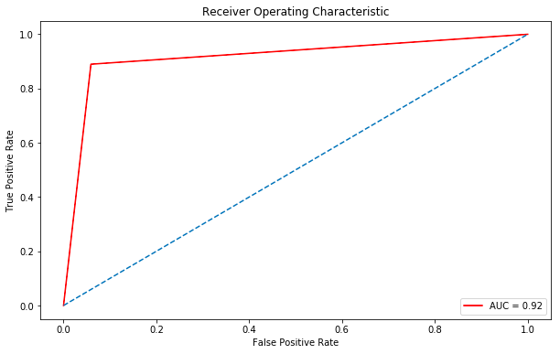
Confusion Matrix:
[ 1961, 123 ]
[ 138, 1113 ]
AUC =92%

Slide 34
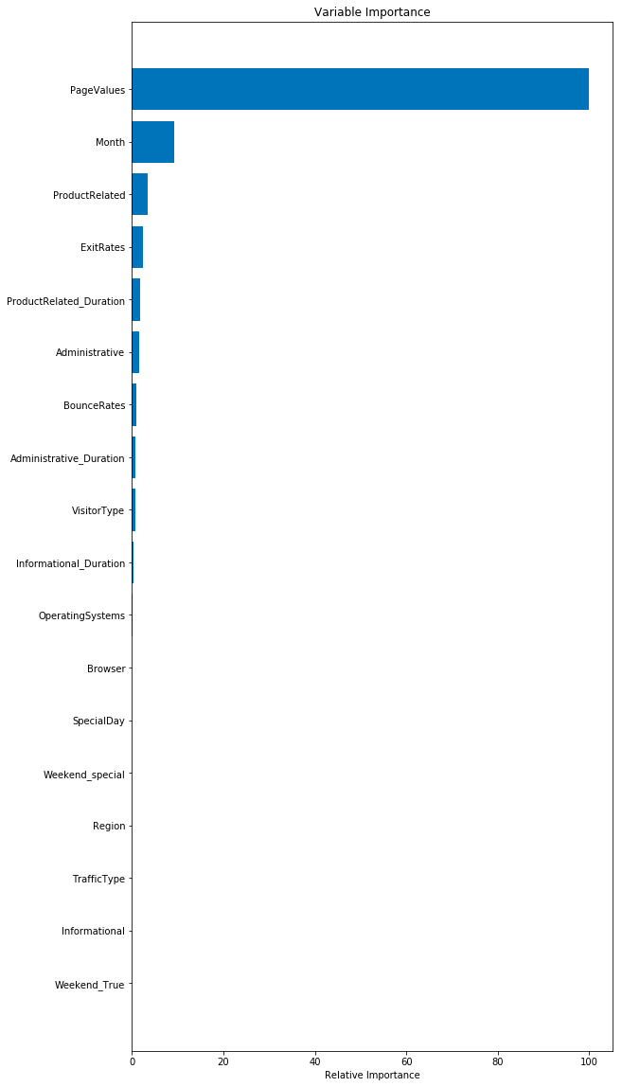
The most important features that are useful to predict the customer intention are :
Page values
Month
Product related pages

Slide 35

Personalised experience to be provided to the New Users along with discounts & Cashbacks for first time users to garner interest among New Users.
Partner with websites where traffic type is high such as customized credit cards with reward points, gift vouchers etc so that customer gives Repeat Business. Implement similar strategy with other websites where traffic type can be Increased.
Change the look & feel of website with Minimum Navigations and more relevant content to users which creates interest to the buyer so that exit rates and bounce rates can be minimized.
Plan for Special Day Events on weekends as conversion rates for Special day events are relatively less on weekdays compared to weekends.

Slide 36

Thank you!

